Slide 1

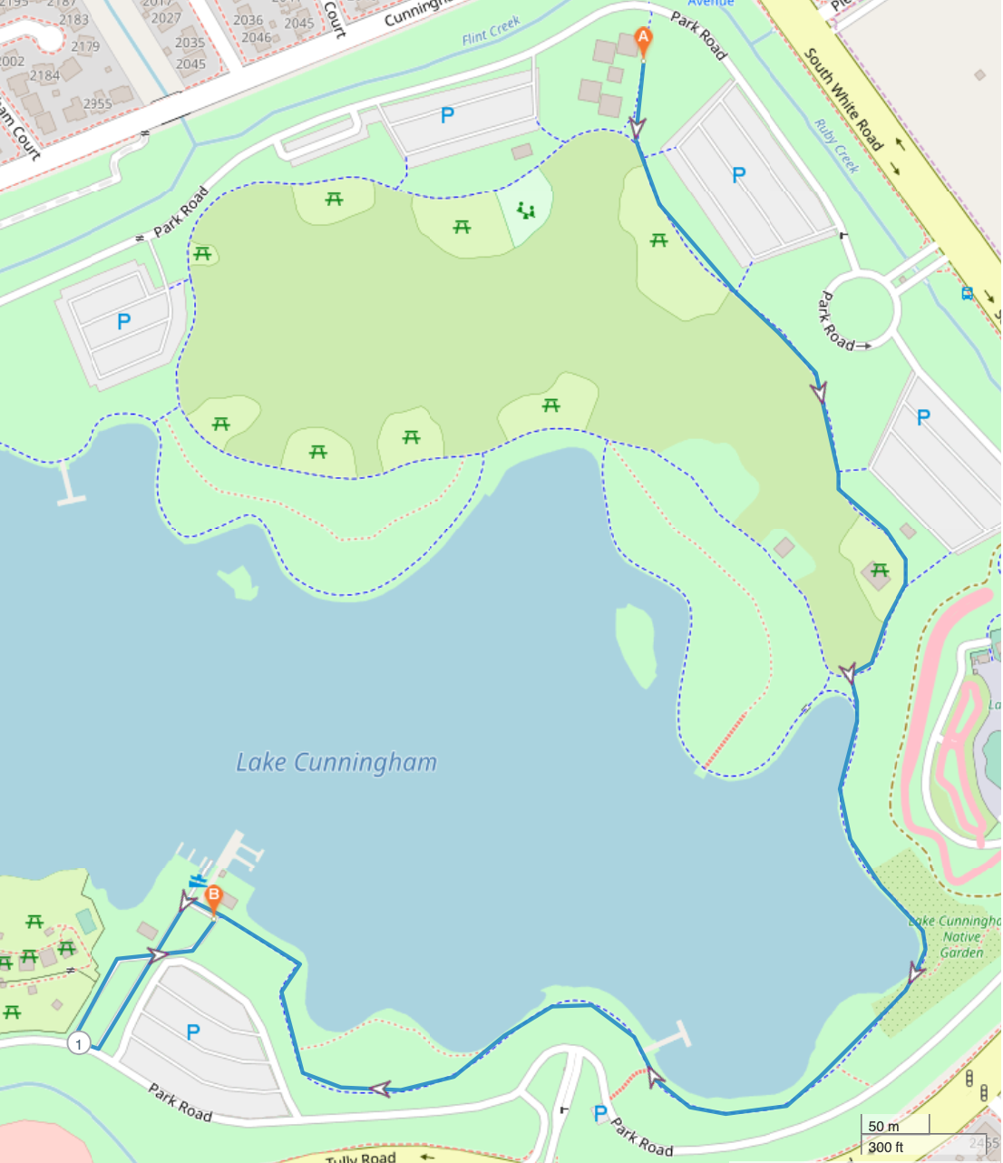
Event site
Moving Day San Jose
Saturday, May 17, 2025
9am-12pm
Lake Cunningham
Contact: Rachel Howsmon
rhowsmon@Parkinson.org
415-598-2890
2 mile walk turnaround point
1 mile walk turnaround point

